Slide 1



Slide 2
Behavior
Gene Denny, CCA
Education Training Supervisor, CIC

Slide 3
Agenda
Components of the Behavior Tab
- Event
- Role
- Resolution
Creating new Events / Resolutions
Behavior Referral Process
Behavior Reports
ILICUG Conference Nov 15, 2011

Slide 4
The Behavior Tab
Events
  Drop list controlled by the district
  Time / Date stamp editable
    Role
      - Pre-defined by Campus and may NOT be edited.
ILICUG Conference Nov 15, 2011

Slide 5
The Behavior Tab
Resolution
  Drop list controlled by district
  Multiple resolutions may be attached to an individual
  Detention Tracker now available as part of Resolutions
ILICUG Conference Nov 15, 2011

Slide 6
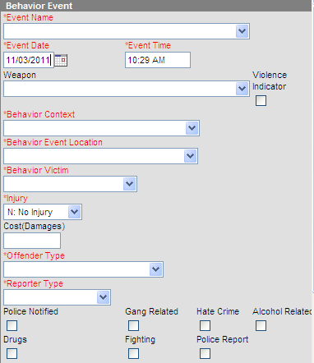
The Behavior Tab (New Fields)

Slide 7
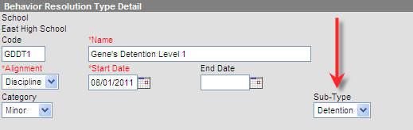
The Behavior Tab
Demonstration of new Detention Tracker
  Must create a Behavior Resolution utilizing the Sub-Type dropdown list for Detention.
The selection of Detention here triggers additional fields to become available for entering duration

Slide 8
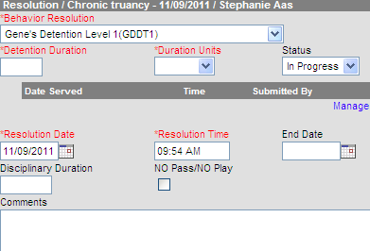
The Behavior Tab
Once the proper Behavior Resolution(s) have been created, they are available when adding to a student’s Event

Slide 9
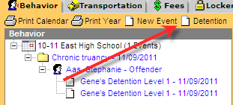
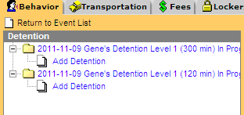
The Behavior Tab
The Behavior Tab also contains a new tool allowing the user to view all Detention obligations at once.

Slide 10
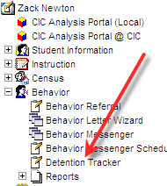
The Detention Tracker
Now that Detention obligations have been assigned, the Detention Tracker allows for easy recording of amount of time served per student

Slide 11
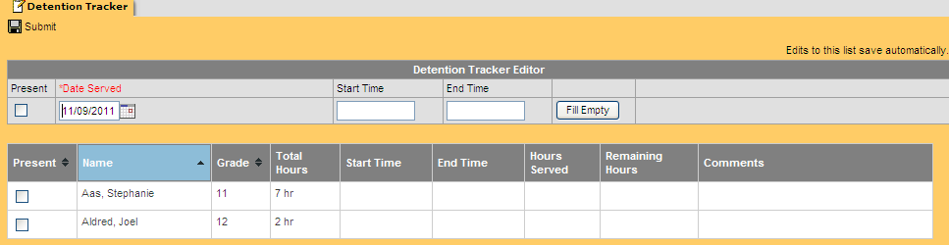
The Detention Tracker
Time may be entered for an entire group of students or one student at a time

Slide 12
Behavior Referral
Demonstration
Task Manager and Messenger must be enabled in the Campus.xml file
ILICUG Conference Nov 15, 2011

Slide 13
Behavior Reports
Events
Resolutions
ILICUG Conference Nov 15, 2011

Slide 14
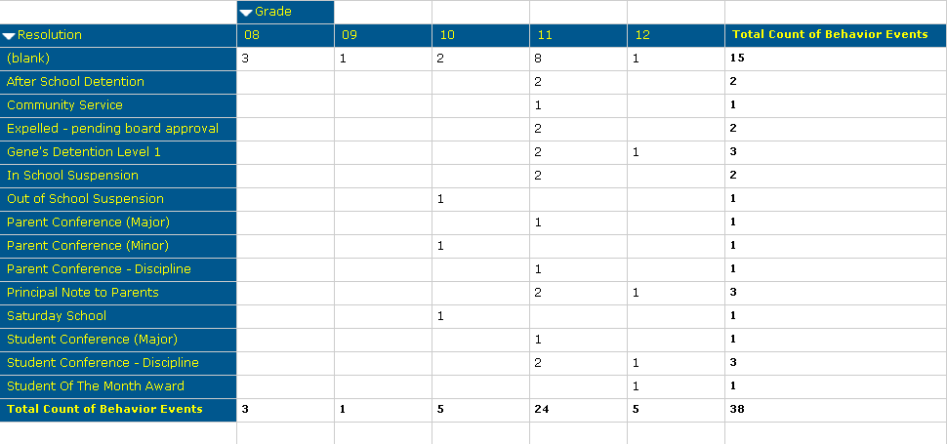
Behavior Reports
Behavior data can also be viewed via the Data Analysis tool
ILICUG Conference Nov 15, 2011

Slide 15
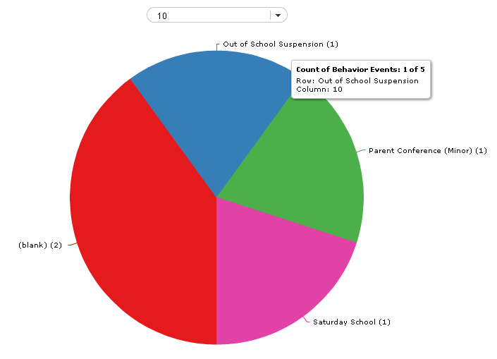
Behavior Reports
ILICUG Conference Nov 15, 2011

Slide 16
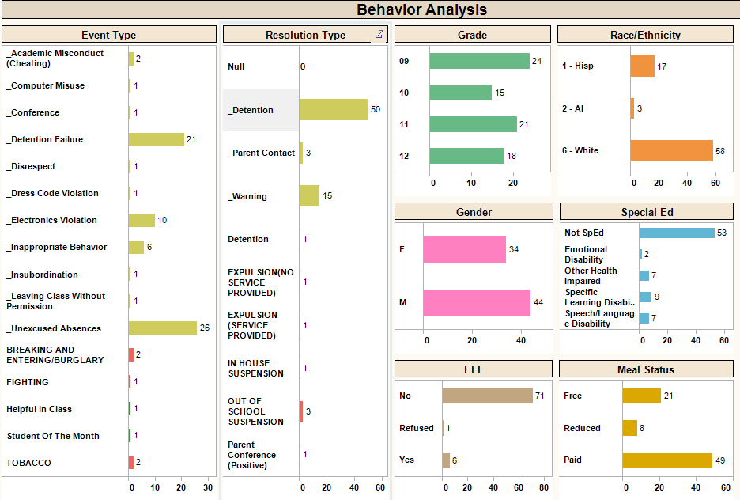
Behavior Reports
Or via Tableau
ILICUG Conference Nov 15, 2011

Slide 17
Questions?

